Slide 1
Nahshon (Nash) Paz nashpaz@gmail.com
Docker workshop
https://github.com/nashpaz123/Please-Contain-Yourself or google: “nashpaz123 please”
Notes:
https://github.com/nashpaz123/Please-Contain-Yourself

Slide 2
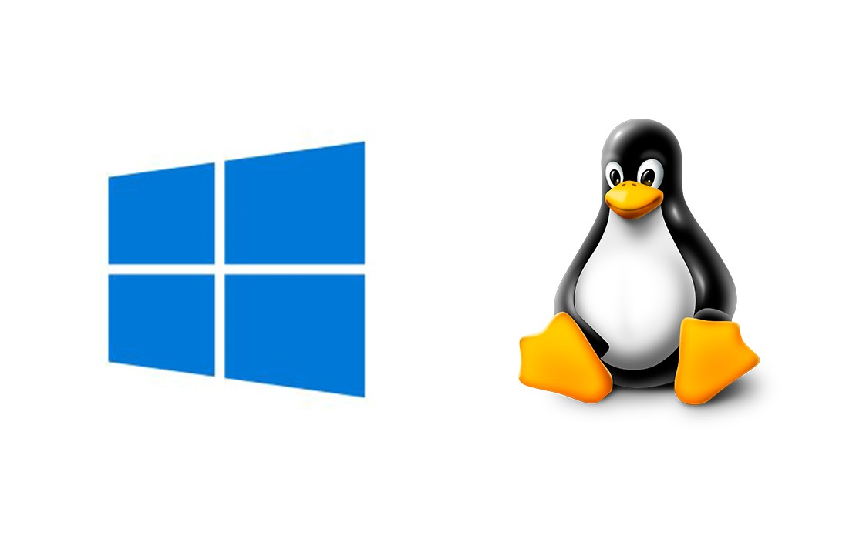
Docker was developed by Docker Inc. but relies heavily on the docker community, Redhat in 2013, MS in 2014
Uses the resource isolation features of the Linux kernel
We’re talking linux here, not windows (Docker desktop…)

Slide 3
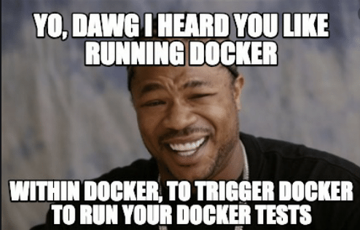
On our list are:
Layers, Images and Containers Terminology
Why Docker
Microservices
Layers, Images and Containers Examples + hands on
Volumes and ports
Use cases
Extra - Network, multi stage
Docker Compose intro
Notes:
docker container run --name my-nginx-container-1 -v /tmp/docker-host/html:/usr/share/nginx/html:ro -p 80:80 -d nginx
echo “<xmp>Hello World</xmp>” > /tmp/docker-host/html/index.html
docker ps
docker exec -it my-nginx-container-1 bash
docker exec my-nginx-container-1 sh -c "find / -iname nginx"
docker rm -f /my-nginx-container-1

Slide 4
Play
Install Docker & Docker Compose - Centos 8
Step 1 — Install Docker
#Install needed packages:
sudo yum install -y yum-utils device-mapper-persistent-data lvm2
#Configure the docker-ce repo:
sudo yum-config-manager --add-repo https://download.docker.com/linux/centos/docker-ce.repo
#Install docker-ce:
sudo yum install docker-ce
#Add your user to the docker group with the following command.
sudo usermod -aG docker $(whoami)
#Set Docker to start automatically at boot time:
sudo systemctl enable docker.service
#Finally, start the Docker service:
sudo systemctl start docker.service
Step 2 — Install Docker Compose
sudo curl –L https://github.com/docker/compose/releases/latest/download/docker-compose-$(uname -s)-$(uname -m) -o /usr/local/bin/docker-compose
Or just https://labs.play-with-docker.com/

Slide 5
Troubleshooting..?
Filesystem access and permissions:
https://stackoverflow.com/questions/51342810/how-to-fix-dial-unix-var-run-docker-sock-connect-permission-denied-when-gro/54504083#54504083
Notes:
docker rmi -f $(docker images -a -q)

Slide 6
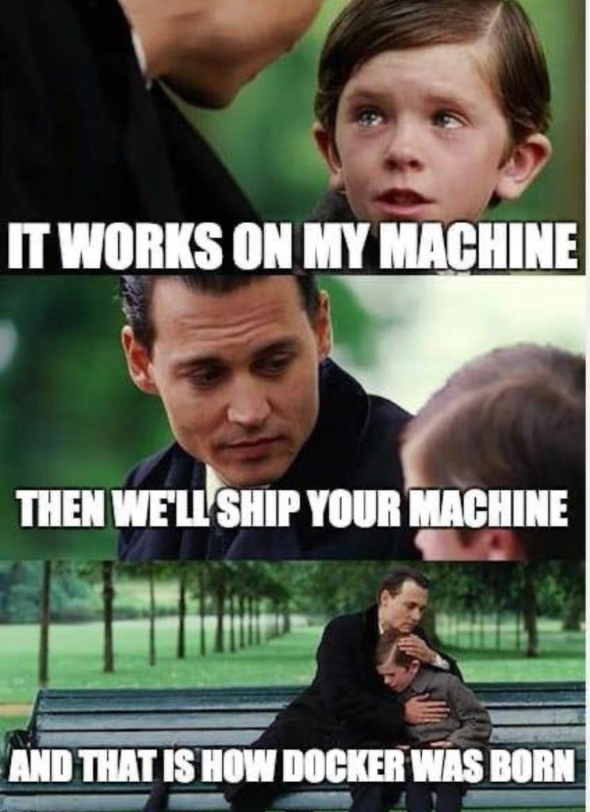
What is a container?
Containers wrap up a piece of software in a complete filesystem that contains everything it needs to run:
Code
Runtime
System tools
System libraries
Notes:
Docker can package an application and its dependencies in a virtual container that can run on any Linux server. This helps provide flexibility and portability enabling the application to be run in various locations, whether on-premises, in a public cloud, or in a private cloud.^{[31]}

Slide 7
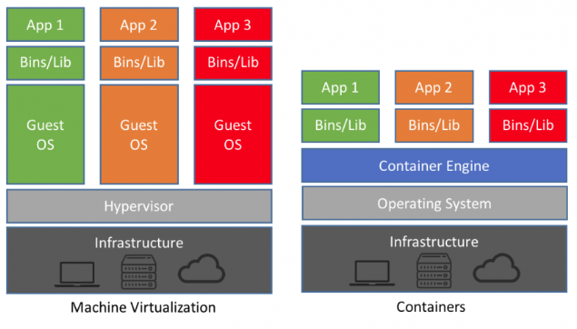
Container vs VM
Whaduyou need an OS for?
Python, Java, node, .Net
Docker installed on host instead of a whole OS
Docker host
Notes:
Docker engine installed on host instead of a whole OS

Slide 8
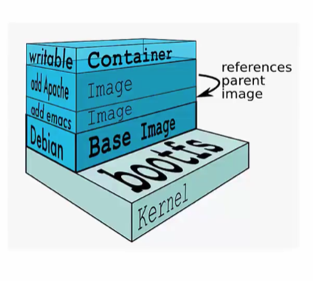
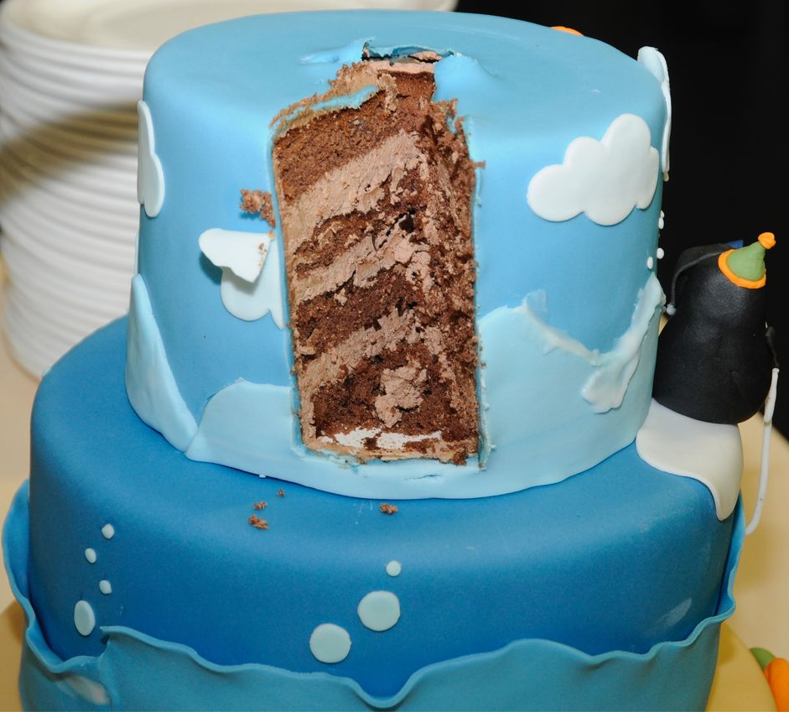
Image→ container = Layers (Dockerfile)
Comprised of multiple layers
A layer is just another image
Every layer contains a base layer
Docker uses a copy on write system
Layers are read only
Try:
docker history <name of an image>
Notes:
On pull a check is made for different layers
Layers can be reused by images. For example, the debian:jessie image shares both layers with debian:latest. Pulling the debian:jessie image therefore only pulls its metadata, but not its layers, because all layers are already present locally:
ll /var/lib/docker/overlay/

Slide 9

Lightweight
Containers running on a single machine share the same operating system kernel;
They start instantly and use less RAM.
Images are constructed from layered filesystems and share common files, making disk usage and image downloads much more efficient.

Slide 10
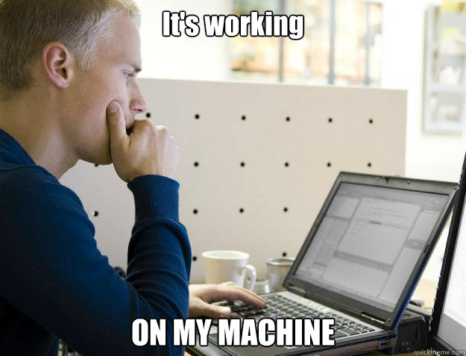
Environment (as a service)
Packaging an application in a container with its configs and dependencies guarantees that the application will always work as designed in any environment.
Same across multiple deployments
Eliminate “Works on my machine”

Slide 11
Docker Use Cases
Development Environment
Quick evaluation of software
Microservices
Unified execution environment (dev → test → prod (local, VM, cloud, …)
Notes:
Multi-Tenancy – with wrapping services (compose, k8s), or each

Slide 12
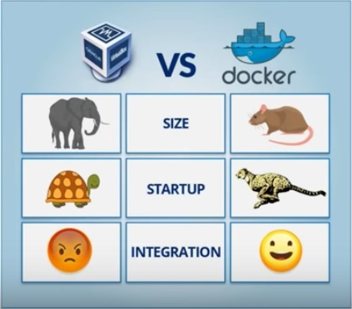
Micro
Microservices vs monolith
Environment is packaged with service
Separation of dev environments, teams
Same across multiple deployments
Speed (size, layers)

Slide 13
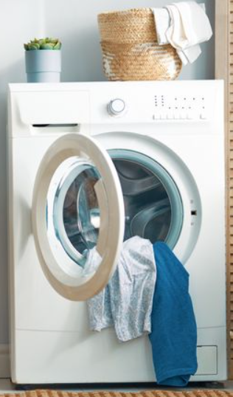


Micro
Finance DB (MySQL)
Finance DBs API service
User
auth
service
Finance DB (MSSQL)
Finance DB (Postgres)
Notes:
לא ללמד את המכונת כביסה לדבר ברווזית, ולא להכניס את הברווז למכונת הכביסה. לשים כרית באמצע שתיקח נוצות מהברווז (ובהמשך מתרנגולת, תוכי או בת יענה)
שירות אוטנטיקציה שמפתחים כתבו בתוכו דיבור עם בסיס נתונים מסוים ואז הוסיפו להם דיבור עם בסיס נתונים מסוג אחר – במקום לכתוב שוב לתוך שירות האוטנטיקציה, קומפוננטה באמצע שתתרגם

Slide 14
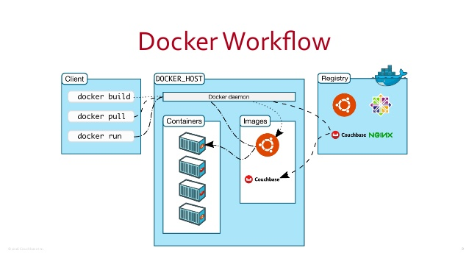
Docker Hub
Public repository of many, many Docker images:
https://hub.docker.com/
Google it!
though you can always run:
docker search centos
Notes:
Automatically build a Docker image on Docker-Hub:
Example: playground-docker-echoey in Bitbucket: https://bitbucket.org/inftec/playground-docker-echoey/overview
Automated Build Repository on Docker Hub: https://registry.hub.docker.com/u/pazoozoo/playground-docker-echoey/
Build took around 5 minutes...
Run on AWS Elastic Beanstalk:
Need to ZIP Dockerfile and dependencies (ADD files)
Beanstalk environment expects HTTP service on first EXPOSEd port though → not working with dummy echo service

Slide 15
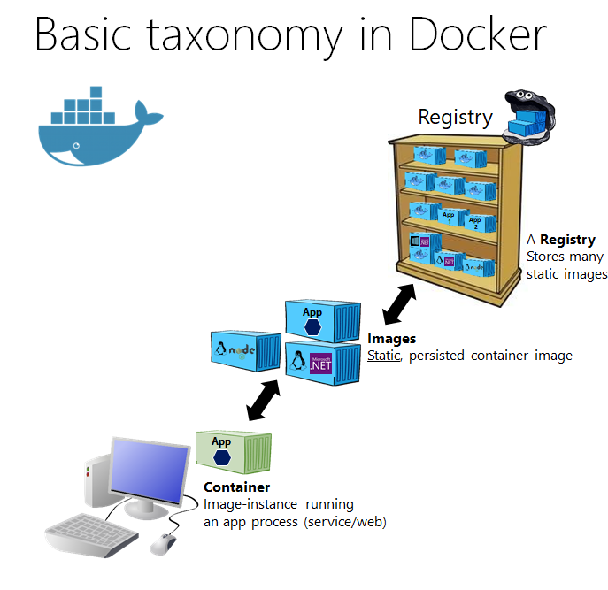
Hello World
Simple Command - Ad-Hoc Container:
Try:
docker run alpine echo Hello World
docker run -d alpine sleep 60
docker images
docker ps
docker container
Notes:
Immediately exits
docker ps
docker ps –a
Re-attach: docker start –i stoic_wozniak
docker commit –m «message» containerId imageName(e.g. mytest/test1:1.0)
New Image
docker images

Slide 16

Terminology - Image
Persisted snapshot that can be run
images (or image ls): List all local images
image tag: Tag an image
image pull: Download image from repository
image rm: Delete a local image
image save: save to file
Notes:
Run -d
Image tag

Slide 17
Terminology - Container
Runnable instance of an image
ps (or container ls): List all running containers
container ls –a: List all containers (incl. stopped)
container top: Display processes of a container
container start: Start a stopped container
container stop: Stop a running container
container stats: host statistics (networking, RAM, CPU)
container rm: Delete a container
container commit: Create an image from a container
container inspect: full configuration of a container
Notes:
docker run --rm to remove container after termination

Slide 18
Terminology - Container
Execute on a running instance of an image
docker exec (for debug purposes)
docker exec -it name_or_id sh
docker exec name_or_id sh -c "ls"
docker logs
docker logs -f name_or_id
Tip:
id = $(docker ps | grep part_of_a_container_name |awk '{print $1}')
Notes:
docker run --rm to remove container after termination

Slide 19
Image vs. Container
Base Image
ubuntu:latest
run
Container
cid1
base image
cmd → new state
New Image
iid1
commit
Container
cid1
run
Container
cid2
Container
cid3
Container
cid4
Notes:
Using commit is debatable as a “dirty” practice
docker commit $(docker ps | grep ngin |awk '{print $1}') nginxcommitedimage:1

Slide 20

https://dockerlabs.collabnix.com/docker/cheatsheet/
Notes:
https://dockerlabs.collabnix.com/docker/cheatsheet/

Slide 21
Dockerfile
Create images automatically using a build script: «Dockerfile»
Can be versioned in a version control system like Git, along with all dependencies
Notes:
RUN, COPY, ADD will create a new layer (which will sit along with existing layers)

Slide 22
Dockerfile Example
Try:
Create a directory name Docker-Ex1
mkdir Docker-Ex1
cd Docker-Ex1
Create a file named message.sh in the Docker-Ex1 directory:
#!/bin/sh
echo This is from my dockerfile
Create a file named Dockerfile (capital D) under Docker-Ex1 directory:
FROM alpine
COPY message.sh /
CMD ["sh", "message.sh"]
cd .. #to go back to the root folder
docker build -t alpine:MyFirstImage Docker-Ex1/ #Note that you must always state the directory in which your Dockerfile exists, . (dot) for the current directory
docker run alpine:MyFirstImage
Notes:
Provide sh (or explain vim)
#!/bin/sh
echo This is from my dockerfile
----------------------------------
FROM alpine
COPY message.sh /
CMD ["sh", "message.sh"]

Slide 23
Dockerfile Selenium from https://github.com/SeleniumHQ/docker-selenium/blob/master/NodeBase/Dockerfile
FROM selenium/base:3.141.59-palladium
LABEL authors=SeleniumHQ
USER root
#==============
# Xvfb
#==============
RUN apt-get update -qqy \
&& apt-get -qqy install \
xvfb \
&& rm -rf /var/lib/apt/lists/* /var/cache/apt/*
#==============================
# Locale and encoding settings
#==============================
ENV LANG_WHICH en
ENV LANG_WHERE US
ENV ENCODING UTF-8
ENV LANGUAGE ${LANG_WHICH}_${LANG_WHERE}.${ENCODING}
ENV LANG ${LANGUAGE}
# Layer size: small: ~9 MB
# Layer size: small: ~9 MB MB (with --no-install-recommends)
RUN apt-get -qqy update \
&& apt-get -qqy --no-install-recommends install \
language-pack-en \
tzdata \
locales \
&& locale-gen ${LANGUAGE} \
&& dpkg-reconfigure --frontend noninteractive locales \
&& apt-get -qyy autoremove \
&& rm -rf /var/lib/apt/lists/* \
&& apt-get -qyy clean
#================
# Font libraries
#================
# libfontconfig ~1 MB
# libfreetype6 ~1 MB
# xfonts-cyrillic ~2 MB
# xfonts-scalable ~2 MB
# fonts-liberation ~3 MB
# fonts-ipafont-gothic ~13 MB
# fonts-wqy-zenhei ~17 MB
# fonts-tlwg-loma-otf ~300 KB
# ttf-ubuntu-font-family ~5 MB
# Ubuntu Font Family, sans-serif typeface hinted for clarity
# Removed packages:
# xfonts-100dpi ~6 MB
# xfonts-75dpi ~6 MB
# Regarding fonts-liberation see:
# https://github.com/SeleniumHQ/docker-selenium/issues/383#issuecomment-278367069
# Layer size: small: 36.28 MB (with --no-install-recommends)
# Layer size: small: 36.28 MB
RUN apt-get -qqy update \
&& apt-get -qqy --no-install-recommends install \
libfontconfig \
libfreetype6 \
xfonts-cyrillic \
xfonts-scalable \
fonts-liberation \
fonts-ipafont-gothic \
fonts-wqy-zenhei \
fonts-tlwg-loma-otf \
ttf-ubuntu-font-family \
&& rm -rf /var/lib/apt/lists/* \
&& apt-get -qyy clean
#===================================================
# Run the following commands as non-privileged user
#===================================================
USER seluser
#==============================
# Scripts to run Selenium Node and XVFB
#==============================
COPY start-selenium-node.sh \
start-xvfb.sh \
/opt/bin/
#==============================
# Supervisor configuration file
#==============================
COPY selenium.conf /etc/supervisor/conf.d/
#============================
# Some configuration options
#============================
ENV SCREEN_WIDTH 1360
ENV SCREEN_HEIGHT 1020
ENV SCREEN_DEPTH 24
ENV DISPLAY :99.0
ENV START_XVFB true
#========================
# Selenium Configuration
#========================
# As integer, maps to "maxInstances"
ENV NODE_MAX_INSTANCES 1
# As integer, maps to "maxSession"
ENV NODE_MAX_SESSION 1
# As address, maps to "host"
ENV NODE_HOST 0.0.0.0
# As integer, maps to "port"
ENV NODE_PORT 5555
# In milliseconds, maps to "registerCycle"
ENV NODE_REGISTER_CYCLE 5000
# In milliseconds, maps to "nodePolling"
ENV NODE_POLLING 5000
# In milliseconds, maps to "unregisterIfStillDownAfter"
ENV NODE_UNREGISTER_IF_STILL_DOWN_AFTER 60000
# As integer, maps to "downPollingLimit"
ENV NODE_DOWN_POLLING_LIMIT 2
# As string, maps to "applicationName"
ENV NODE_APPLICATION_NAME ""
# Debug
ENV GRID_DEBUG false
# Following line fixes https://github.com/SeleniumHQ/docker-selenium/issues/87
ENV DBUS_SESSION_BUS_ADDRESS=/dev/null
# Creating base directory for Xvfb
RUN sudo mkdir -p /tmp/.X11-unix && sudo chmod 1777 /tmp/.X11-uni

Slide 24
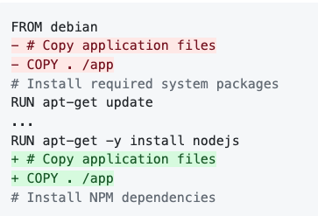
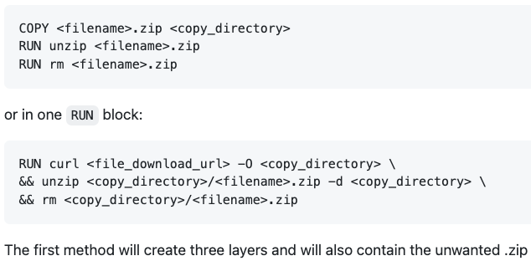
Best practices
Use cache – changeable layers at the end (if a COPY line introduces change first, all subsequent RUN commands will run without cache and take a long time and make larger layers!)
RUN several commands with && as one layer if expecting changes
.Dockerignore
**/.classpath **/.dockerignore **/.env **/.git **/.gitignore **/.project **/.settings **/.toolstarget **/.vs **/.vscode **/*.*proj.user **/*.dbmdl **/*.jfm **/azds.yaml **/bin **/charts **/docker-compose* **/Dockerfile* **/node_modules **/npm-debug.log **/obj **/secrets.dev.yaml **/values.dev.yaml LICENSE README.md
Notes:
https://dev.to/azure/improve-your-dockerfile-best-practices-5ll

Slide 25
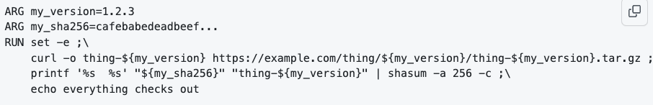
More practices
Run as non-root where possible
RUN useradd -r -u 1001 -g root nonroot
RUN chmod -R g+rwX /var/log #for usability by non root
USER nonroot
Redirect your apps log to stdout: e.g
RUN ln -sf /dev/stdout /var/log/app.log
Set the WORKDIR instruction to avoid surprises
WORKDIR /app #for following copy and cmd instructions
Use alpine for smaller size, tool images for tools
If variables repeat themselves, use ARG (can cause a cache miss) as opposed to ENV
Notes:
https://github.com/dnaprawa/dockerfile-best-practices

Slide 26
More practices
Entrypoints as .sh script rather than a command
Entrypoint and CMD:
CMD = command to run if no arguments replace it,
ENTRYPOINT = image behaves like a binary. (docker run or exec start a service)
If the Dockerfile declares both ENTRYPOINT and CMD and no arguments
are passed to docker run, then the argument(s) to CMD are passed to the declared entrypoint.
#Dockerfile
FROM ubuntu:trusty
ENTRYPOINT ["/bin/ping","-c","3"]
CMD ["localhost"]
Try:
docker build -t pinger .
docker run pinger
docker run pinger google.com
Notes:
https://github.com/nginxinc/docker-nginx/blob/master/stable/alpine/Dockerfile
https://github.com/nuxeo/docker-nuxeo/tree/master/10.10 #google nuxeo dockerfile

Slide 27
Dockerfile cheetsheet
Set image to trigger an instruction when used as a base (FROM) for another image:
ONBUILD ADD . /app/src ONBUILD
RUN /usr/local/bin/python-build --dir /app/src
Check every five minutes or so that a web-server is able to serve the site’s main page within three seconds. Exits if unavailable:
HEALTHCHECK --interval=5m --timeout=3s \ CMD curl -f http://localhost/ || exit 1
SHELL
FROM microsoft/windowsservercore
# Executed as cmd /S /C echo default
RUN echo default
# Executed as cmd /S /C powershell -command Write-Host default
RUN powershell -command Write-Host default
# Executed as powershell -command Write-Host hello
SHELL ["powershell", "-command"]
RUN Write-Host hello
# Executed as cmd /S /C echo hello
SHELL ["cmd", "/S", "/C"]
RUN echo hello
Notes:
https://dockerlabs.collabnix.com/docker/cheatsheet/

Slide 28
Notes:
https://kapeli.com/cheat_sheets/Dockerfile.docset/Contents/Resources/Documents/index

Slide 29
More options
docker container run -t -p 8080:80 ubuntu
Map container port 80 to host port 8080
docker container run -t -e ENV_VAR_A=value1 ubuntu
Add environment variable to the container
docker container run -d ubuntu
Detached mode
Notes:
Use ifconfig -> eht1 to access from host

Slide 30
Mount Volumes
Volumes help save data outside the container so the data won’t get lost when the container stops running.
docker run –ti -v vol_name:/<path inside container> alpine
Can be shared and reused among one or many containers
Updates to an image won’t affect a data volume
Data volumes are persisted even after container deletion
Volumes are OS agnostic. They can run on Linux and windows containers
Volumes drivers allow us to store volumes on remote hosts or cloud providers.
Volumes can be encrypted or to add other functionality
Notes:
Use docker start, docker attach to reuse container
Change script to echo ... >> /log/hello3.log

Slide 31
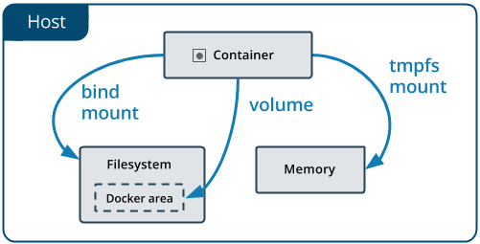
Mount Volumes
Volumes are stored in a part of the host filesystem which is managed by Docker (/var/lib/docker/volumes/ on Linux). Non-Docker processes should not modify this part of the filesystem. Volumes are the best way to persist data in Docker.
Bind mounts may be stored anywhere on the host system. They may even be important system files or directories. Non-Docker processes on the Docker host or a Docker container can modify them at any time.
docker run –ti -v </path/outside/of/docker/root/dir>:/<path inside container> alpine
Notes:
Use docker start, docker attach to reuse container
Change script to echo ... >> /log/hello3.log

Slide 32
Mount Volumes
Good use cases for volumes (container read/write to remote, somewhat faster)
Volumes are the preferred way to persist data in Docker containers and services. Some use cases for volumes include:
Sharing data among multiple running containers. If you don’t explicitly create it, a volume is created the first time it is mounted into a container. When that container stops or is removed, the volume still exists. Multiple containers can mount the same volume simultaneously, either read-write or read-only. Volumes are only removed when you explicitly remove them.
When the Docker host is not guaranteed to have a given directory or file structure. Volumes help you decouple the configuration of the Docker host from the container runtime.
When you want to store your container’s data on a remote host or a cloud provider, rather than locally.
When your application requires high-performance I/O on Docker Desktop. Volumes are stored in the Linux VM rather than the host, which means that the reads and writes have much lower latency and higher throughput.
When your application requires fully native file system behavior on Docker Desktop. For example, a database engine requires precise control over disk flushing to guarantee transaction durability. Volumes are stored in the Linux VM and can make these guarantees, whereas bind mounts are remoted to macOS or Windows, where the file systems behave slightly differently.
Notes:
Use docker start, docker attach to reuse container
Change script to echo ... >> /log/hello3.log

Slide 33
Mount Volumes
Good use cases for bind mounts (temp relations with host)
In general, you should use volumes where possible. Bind mounts are appropriate for the following types of use case:
Sharing configuration files from the host machine to containers. This is how Docker provides DNS resolution to containers by default, by mounting /etc/resolv.conf from the host machine into each container.
Sharing source code or build artifacts between a development environment on the Docker host and a container. For instance, you may mount a Maven target/ directory into a container, and each time you build the Maven project on the Docker host, the container gets access to the rebuilt artifacts.
If you use Docker for development this way, your production Dockerfile would copy the production-ready artifacts directly into the image, rather than relying on a bind mount.
When the file or directory structure of the Docker host is guaranteed to be consistent with the bind mounts the containers require.
Notes:
Use docker start, docker attach to reuse container
Change script to echo ... >> /log/hello3.log

Slide 34
Terminology - Volume
create Create a volume
inspect Display detailed information on one or more volumes
ls List volumes
prune Remove all unused local volumes
rm Remove one or more volumes
Notes:
docker run --rm to remove container after termination
docker inspect my-nginx-container-1 | grep -A10 Mounts

Slide 35
No Mounted Volumes ☹
Try:
docker container run -ti --name alpine alpine sh
cd /home
echo “This is my file” > myfile
ls –l
exit
docker container rm alpine
docker container run -ti --name alpine alpine sh
cd /home
ls –l
exit

Slide 36
Mount Volumes - Cont’
Try:
docker container run -ti -v myVol:/home --name alpine alpine sh
cd /home
echo “This is my file” > myfile
ls -l
exit
----------------------------------------------------------
docker container rm alpine
docker container run -ti --name alpine alpine sh
cd /home
ls -l
exit

Slide 37
Publish Port
Try:
Create a directory named Dockerfile-Ex2
Create a Dockerfile file under a new folder, Dockerfile-Ex2 :
FROM busybox
COPY index.html /www/index.html
EXPOSE 8000
CMD trap "exit 0;" TERM INT; httpd -p 8000 -h /www -f & wait
Create a index.html file under the folder Dockerfile-Ex2 –
vim Dockerfile-Ex2/index.html
<xmp>Hello World</xmp>
docker image build -t busybox:HelloWorld Dockerfile-Ex2
docker container run -d --name web-test -p 80:8000 busybox:HelloWorld
Notes:
Use ifconfig -> eht1 to access from host

Slide 38
Running Jenkins on a container
Try:
Google “jenkins docker”
Go to docker hub, https://hub.docker.com/_/jenkins
Oh! DEPRECATION NOTICE
Go to the jenkins/jenkins:lts link → documentation https://github.com/jenkinsci/docker/blob/master/README.md
Run:
docker run -v jenkins_home:/var/jenkins_home -p 8080:8080 -p 50000:50000 jenkins/jenkins:lts-jdk11
(-d to run detached…)
In the console you’ll see the “initial password”
Wait for it…
Go to http://<your machine’s ip>:8080
Notes:
Create a job/change settings. rm –f container (restart your laptop/VM crashed) then run it again, the changes will persist.

Slide 39
Micro DB, loads of data
Try:
mkdir -p /storage/docker/mysql-data
docker run --detach --name=mysql_server_1 --env="MYSQL_ROOT_PASSWORD=my_password" --publish 6603:3306 --volume=/storage/docker/mysql-data:/var/lib/mysql mysql
docker run --rm -it bitnami/mariadb bash
mysql -uroot -pmy_password -h<ip of the docker host> -P6603
USE mysql
CREATE TABLE IF NOT EXISTS tasks (task_id INT AUTO_INCREMENT PRIMARY KEY,title VARCHAR(255) NOT NULL,start_date DATE,due_date DATE,status TINYINT NOT NULL,priority TINYINT NOT NULL,description TEXT,created_at TIMESTAMP DEFAULT CURRENT_TIMESTAMP);
exit
exit
ls -l /storage/docker/mysql-data/mysql
Notes:
Create a job/change settings. rm –f container (restart your laptop/VM crashed) then run it again, the changes will persist.
mysql -uroot -pmy_password -h<ip of the docker host> -P6603

Slide 40
Web server random ports
Try:
docker container run --name my-nginx-container-1 -v /tmp/docker-host/html:/usr/share/nginx/html:ro -P -d nginx
docker container ps (note the ports)
curl http://localhost:<port that’s mapped to 80 of the container>
Or browse http://<ip or docker host name>:<port that’s mapped to 80 of the container>
------------------------------------------------------------------------------------------
Try:
vim Dockerfile
FROM nginx
COPY /tmp/docker-host/html /usr/share/nginx/html
docker image build -t my-nginx-image-1 .
docker container run --name my-nginx-container-2 -P -d my-nginx-image-1
docker container ps (note the ports for my-nginx-container-2)
curl http://localhost:<port that’s mapped to 80 of my-nginx-container-2 >
Or browse http://<ip or docker host name>:<port that’s mapped to 80 of my-nginx-container-2 >
Notes:
mkdir -p /tmp/docker-host/html
vim /tmp/docker-host/html/index.html ,
https://www.bogotobogo.com/DevOps/Docker/Docker_Nginx_WebServer.php
-P (capital p) option tells Docker to map those ports to ports on the Docker host that are randomly selected from the range between 49153 and 65535. We’re gonna run a bunch of containers and don’t want port conflicts/specify ports for each container

Slide 41
Selenium grid
Run:
docker run -d -p 4444:4444 --name selenium-hub selenium/hub
go to http://<ip or computer name>:4444/grid/console
See:
docker logs $(docker ps |grep selenium/hub|awk '{print $1}’)
docker ps –a
docker run -d --link selenium-hub:hub selenium/node-chrome
docker run -d --link selenium-hub:hub selenium/node-firefox
go to http://<ip or computer name>:4446/grid/console
See:
docker logs $(docker ps |grep selenium/hub|awk '{print $1}’)
Notes:
http://www.testautomationguru.com/selenium-grid-setup-using-docker/
https://examples.javacodegeeks.com/core-java/selenium-grid-docker-tutorial/
https://www.dev2qa.com/setup-selenium-grid-with-docker/
https://www.seleniumeasy.com/selenium-tutorials/configure-selenium-grid-using-docker
https://github.com/nashpaz123/selenium/blob/master/Jenkinsfile-tests
//variables //Nash: deprecated pre k8s grid, was replaced with dynamic slaves over k8s def network='jenkins-${BUILD_NUMBER}' def seleniumHub='selenium-hub-${BUILD_NUMBER}' def chrome='chrome-${BUILD_NUMBER}' def firefox='firefox-${BUILD_NUMBER}' def containertest='conatinertest-${BUILD_NUMBER}' pipeline { agent any stages{ stage('Setting Up Selenium Grid') { steps{ sh "docker network create ${network}" sh "docker run -d -p 4444:4444 --name ${seleniumHub} --network ${network} selenium/hub" sh "docker run -d -e HUB_PORT_4444_TCP_ADDR=${seleniumHub} -e HUB_PORT_4444_TCP_PORT=4444 --network ${network} --name ${chrome} selenium/node-chrome" sh "docker run -d -e HUB_PORT_4444_TCP_ADDR=${seleniumHub} -e HUB_PORT_4444_TCP_PORT=4444 --network ${network} --name ${firefox} selenium/node-firefox" } } stage('Run Test') { steps{ parallel( "search-module":{ // a directory 'search' is created for container test-output sh "docker run --rm -e SELENIUM_HUB=${seleniumHub} -e BROWSER=firefox -e MODULE=search-module.xml -v ${WORKSPACE}/search:/usr/share/tag/test-output --network ${network} nashpaz1/containertest" //archive all the files under 'search' directory archiveArtifacts artifacts: 'search/**', fingerprint: true }, "order-module":{ // a directory 'order' is created for container test-output sh "docker run --rm -e SELENIUM_HUB=${seleniumHub} -e BROWSER=chrome -e MODULE=order-module.xml -v ${WORKSPACE}/order:/usr/share/tag/test-output --network ${network} nashpaz1/containertest" //archive all the files under 'order' directory archiveArtifacts artifacts: 'order/**', fingerprint: true } ) } } } post{ always { sh "docker rm -vf ${chrome}" sh "docker rm -vf ${firefox}" sh "docker rm -vf ${seleniumHub}" sh "docker network rm ${network}" } } }

Slide 42
Selenium grid – cont’
docker-compose.yml - https://raw.githubusercontent.com/SeleniumHQ/docker-selenium/trunk/docker-compose-v3.yml
version: "3"
services:
chrome:
image: selenium/node-chrome:4.1.2-20220208
shm_size: 2gb
depends_on:
- selenium-hub
environment:
- SE_EVENT_BUS_HOST=selenium-hub
- SE_EVENT_BUS_PUBLISH_PORT=4442
- SE_EVENT_BUS_SUBSCRIBE_PORT=4443
edge:
image: selenium/node-edge:4.1.2-20220208
shm_size: 2gb
depends_on:
- selenium-hub
environment:
- SE_EVENT_BUS_HOST=selenium-hub
- SE_EVENT_BUS_PUBLISH_PORT=4442
- SE_EVENT_BUS_SUBSCRIBE_PORT=4443
firefox:
image: selenium/node-firefox:4.1.2-20220208
shm_size: 2gb
depends_on:
- selenium-hub
environment:
- SE_EVENT_BUS_HOST=selenium-hub
- SE_EVENT_BUS_PUBLISH_PORT=4442
- SE_EVENT_BUS_SUBSCRIBE_PORT=4443
selenium-hub:
image: selenium/hub:4.1.2-20220208
container_name: selenium-hub
ports:
- "4442:4442"
- "4443:4443"
- "4444:4444"
Run:
docker-compose up --scale chrome=5 -d
See: docker ps, browse to: http://<ip or computer name>:4444/grid/console
Notes:
https://raw.githubusercontent.com/SeleniumHQ/docker-selenium/trunk/docker-compose-v3.yml

Slide 43
.NET + SQL
Docker-compose.yml: https://github.com/nashpaz123/cf_api_net_core/blob/main/src/CF.Api/docker-compose.yml
version: "3"
services:
api:
build:
context: ..
dockerfile: CF.Api/Dockerfile
ports:
- "8888:80"
depends_on:
- db
db:
image: "mcr.microsoft.com/mssql/server"
environment:
SA_PASSWORD: ”password"
ACCEPT_EULA: "Y"
Notes:
https://d1.awsstatic.com/whitepapers/modernize-dotnet-apps-with-linux-containers.pdf?did=wp_card&trk=wp_card
https://github.com/leandro-cervelin/cf_api_net_core
https://github.com/achermack/asp-net-core-webapi-sqlserver
https://samwalpole.com/how-to-run-aspnet-core-and-sql-server-from-docker
v https://github.com/federicodiluca/DotNet-SqlServer-DockerDemo
https://github.com/sandeepchugh/shopping-app
https://github.com/raschmitt/net-core-docker-sample/blob/master/src/Dockerfile
https://docs.docker.com/samples/aspnet-mssql-compose/
https://github.com/hd9/aspnet-microservices
https://docs.microsoft.com/en-us/aspnet/core/host-and-deploy/docker/building-net-docker-images?view=aspnetcore-6.0

Slide 45
Docker networks
try:
docker network ls
docker run -itd --name=networktest ubuntu #new containers join default bridge network
docker network inspect bridge
docker ps
docker network create -d bridge od_bridge #-d or --driver is the type
docker run -d --net=od_bridge --name db training/postgres
docker run -d --net=od_bridge --name web training/webapp python app.py
docker container exec db ping web

Slide 46
Docker networks
Overlay network
native multi-host networking (Allows a multiple hosts cluster, e.g. swarm or k8s)
require a valid key-value store service, such as Consul, Etcd, or ZooKeeper.
docker network create --driver overlay my_multi_host_network
Notes:
macVLAN – can be attached along with bridge so allows a hack to allow two networks for one container… Macvlan network allow us to assign a MAC address to a container for making it appear as physical device on our network. Usually to be used with legacy or HW required product that must have a MAC and being directly connected to the physical network to operate.

Slide 47
Multistage CI/CD
# ---- Base Node ----
FROM alpine:3.5 AS base
# install node
RUN apk add --no-cache nodejs-current tini
# set working directory
WORKDIR /root/chat
# Set tini as entrypoint
ENTRYPOINT ["/sbin/tini", "--"]
# copy project file
COPY package.json .
#
# ---- Dependencies ----
FROM base AS dependencies
# install node packages
RUN npm set progress=false && npm config set depth 0
RUN npm install --only=production
# copy production node_modules aside
RUN cp -R node_modules prod_node_modules
# install ALL node_modules, including 'devDependencies'
RUN npm install
#
# ---- Test ----
# run linters, setup and tests
FROM dependencies AS test
COPY . .
RUN npm run lint && npm run setup && npm run test
#
# ---- Release ----
FROM base AS release
# copy production node_modules
COPY --from=dependencies /root/chat/prod_node_modules ./node_modules
# copy app sources
COPY . .
# expose port and define CMD
EXPOSE 5000
CMD npm run start
FROM golang:1.7.3 AS builder
WORKDIR /go/src/href-counter/
RUN go get -d -v golang.org/x/net/html
COPY app.go .
RUN go build -a -installsuffix cgo -o app .
FROM alpine:latest
RUN apk --no-cache add ca-certificates
WORKDIR /root/
COPY --from=builder /go/src/href-counter/app .
CMD ["./app"]
Notes:
docker build --target nameOfSomeStage -t example-node:latest . //stops at a certain stage
FROM stagename1 AS stagename2 //use previous stage as new stage to continue after end of previous
FROM alpine AS builder
WORKDIR /app
RUN echo "He" > ./some_file.txt
# Production env
FROM alpine
WORKDIR /app
COPY --from=builder /app/some_file.txt ./some_file.txt
CMD ["/bin/bash", "-c", "sleep 12000000"]
EXPOSE 80

Slide 48
Multistage CI/CD
https://github.com/nashpaz123/cf_api_net_core
FROM mcr.microsoft.com/dotnet/aspnet:5.0-buster-slim AS base
WORKDIR /app
EXPOSE 80
EXPOSE 443
FROM mcr.microsoft.com/dotnet/sdk:5.0-buster-slim AS build
WORKDIR /src
COPY ["CF.Api/CF.Api.csproj", "CF.Api/"]
RUN dotnet restore "CF.Api/CF.Api.csproj"
COPY . .
WORKDIR "/src/CF.Api"
RUN dotnet build "CF.Api.csproj" -c Release -o /app/build
FROM build AS publish
RUN dotnet publish "CF.Api.csproj" -c Release -o /app/publish
FROM base AS final
WORKDIR /app
COPY --from=publish /app/publish .
ENTRYPOINT ["dotnet", "CF.Api.dll"]
RUN chmod +x ./entrypoint.sh
CMD /bin/bash ./entrypoint.sh
git clone https://github.com/dotnet/dotnet-docker:
# https://hub.docker.com/_/microsoft-dotnet
FROM mcr.microsoft.com/dotnet/sdk:5.0 AS build
WORKDIR /source
# copy csproj and restore as distinct layers
COPY *.sln .
COPY aspnetapp/*.csproj ./aspnetapp/
RUN dotnet restore
# copy everything else and build app
COPY aspnetapp/. ./aspnetapp/
WORKDIR /source/aspnetapp
RUN dotnet publish -c release -o /app --no-restore
# final stage/image
FROM mcr.microsoft.com/dotnet/aspnet:5.0
WORKDIR /app
COPY --from=build /app ./
ENTRYPOINT ["dotnet", "aspnetapp.dll"]
Notes:
git clone https://github.com/dotnet/dotnet-docker
https://github.com/nashpaz123/cf_api_net_core/blob/main/src/CF.Api/Dockerfile

Slide 49
Clean slate
docker stop $(sudo docker ps -a -q) # sends SIGTERM,then SIGKILL
docker rm $(sudo docker ps -a -q) # removes from docker ps -a
docker rm –f #just sends SIGKILL then removes state
docker ps -a
Notes:
docker rmi -f $(docker images -a -q)

Slide 50
Exercises
If you’d like an extra review of the basics:
https://github.com/nashpaz123/Please-Contain-Yourself/tree/master/2-Long_Lived_Containers
If you’re comfortable with docker, go for the app:
https://github.com/nashpaz123/Please-Contain-Yourself/tree/master/3-Bundle_Your_App_Into_An_Image
If you’re done with plain old docker, try docker-compose:
https://github.com/nashpaz123/Please-Contain-Yourself/tree/master/6-Docker_Compose_For_Multi-Container_Apps
Net core + mssql:
https://github.com/nashpaz123/cf_api_net_core
Net core robust project, needs building (e.g with visual studio):
https://github.com/nashpaz123/aspnet-microservices
Add nuget to Web app, or run without web:
docker-compose -f docker-compose.debug.yml up

Slide 51
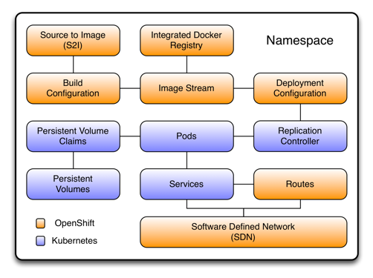
What will they think of next?
GUI (Portainer)
multiple, scale (Docker-compose)
Orchestration (Kubernetes)
PaaS (Openshift)
https://kubernetes.io/blog/2020/12/02/dont-panic-kubernetes-and-docker/
Notes:
https://kubernetes.io/blog/2020/12/02/dont-panic-kubernetes-and-docker/

Slide 52
Docker or Dockerless?
Podman = faster?
https://youtu.be/1UnkRojeEGw?t=28
Buildkit (currently only supports linux containers)
https://docs.docker.com/develop/develop-images/build_enhancements/
https://pythonspeed.com/articles/docker-buildkit/
Or both:
https://pythonspeed.com/articles/podman-buildkit/
Notes:
https://www.vshn.ch/blog/vshn-timer-81-podman-vs-docker-face-off/

Slide 53
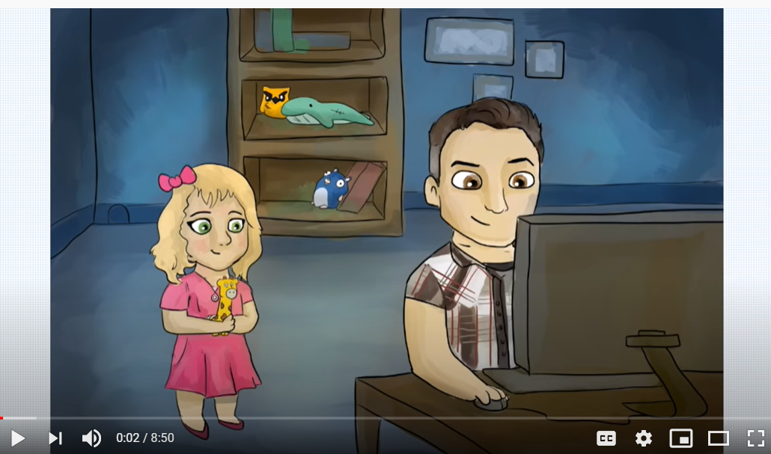
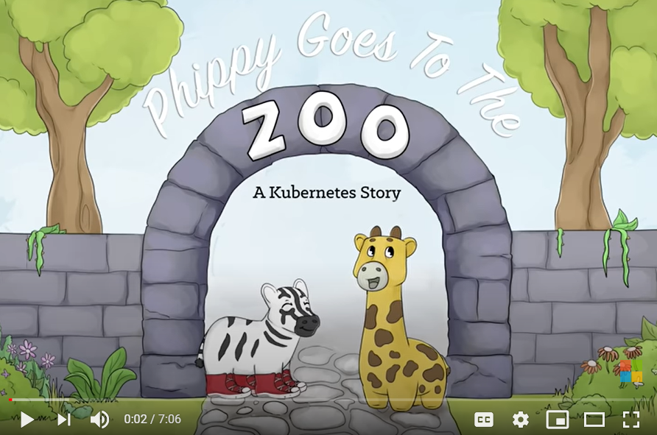
Orchestration (Kubernetes)
The Illustrated Children's Guide to Kubernetes
A Kubernetes story: Phippy goes to the zoo

